Slide 1

INGREDIENT CONSUMPTION TRACKER APPLICATION
Your Personal Healthcare Assistant
Major Project
Under the supervision of:
Dr. Himanshu Mittal
Presented by:
Anshika Bajpai (9917103009)
Vishal Kumar (9917103204)
Rohan Kumar (9917103227)

Slide 2
PROBLEM STATEMENT
National Nutrition Surveys done over the past 25 years show that there is a significant change in the consumption patterns particularly in urban and rural areas. The variety of packaged food items has been increasing due to high demand among the population.
Every age group consumes packaged food items based on their requirements or comforts.
There is a need to study what is the pattern of ingredients that are being consumed by the adolescents and make them aware of it.
It is also necessary to suggest them about the varied level of ingredients or nutrients in their body and the adverse effect of a certain type of ingredient. Also suggesting them different food combinations to balance the high and low level of ingredients/nutrients.

Slide 3
State-of-the-Art
Food Intolerances - Food Intolerances is focused on aiding people with allergies and food sensitivities. It doesn’t focus on ingredients and nutritional value.
AVA - This is a chatbot based platform which tracks symptoms and their corresponding diseases. The chatbot interacts with user via questionnaire and it does not focus on user’s previous ingredient consumption pattern.

Slide 4
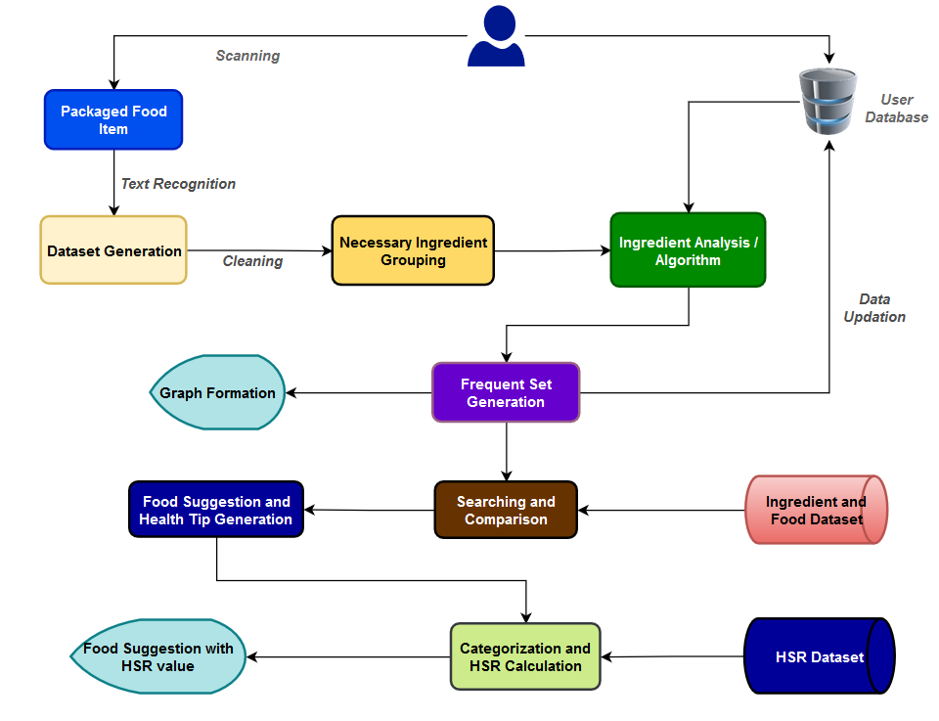
WORKFLOW
We can generate the dataset based on Android Platform with Firebase where users can log their packaged food consumption data.
Data cleaning and data preprocessing.
Testing the data on multiple algorithms like Apriori, ECLAT, FP Growth
Displaying the frequent set data on chart

Slide 5
WORKFLOW
Created an Ingredient-Food dataset and Disease dataset.
Applying and modifying the efficient algorithms to achieve the results.
Suitable steps to search and suggest the food items.
Creation of HSR dataset.
Categorization and HSR calculation.
Appropriate food item suggestion.

Slide 6
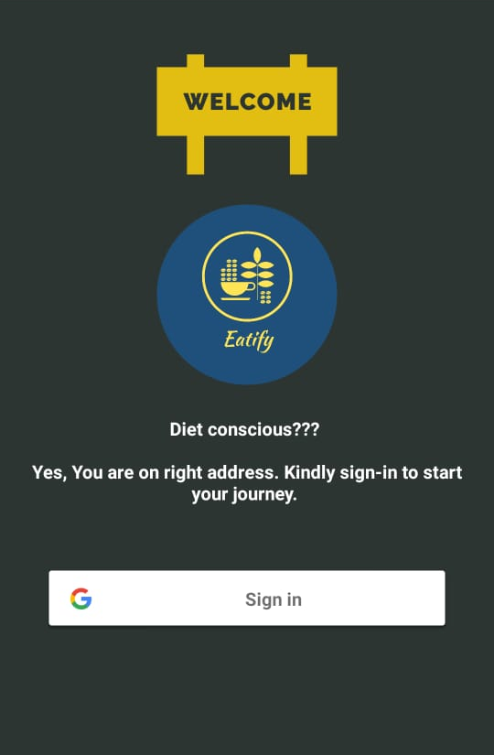
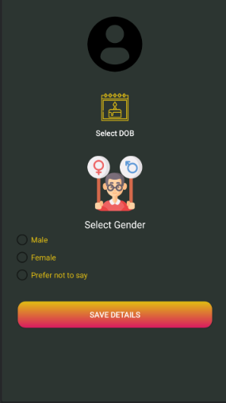
SAMPLE
SCREENSHOTS
AUTHENTICATION
USER DETAILS

Slide 7
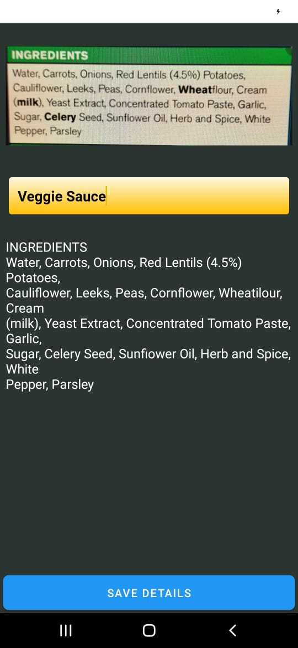
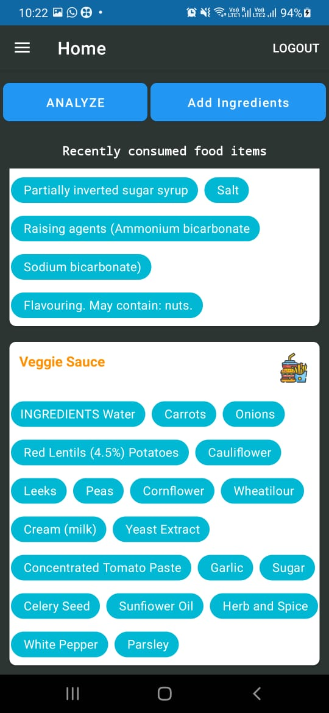
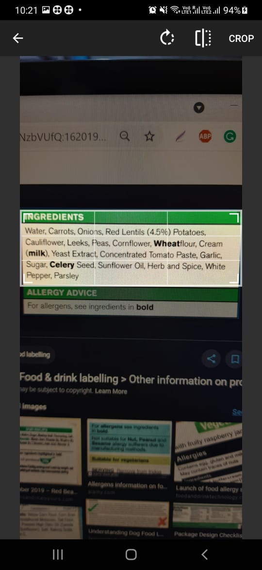

Slide 8
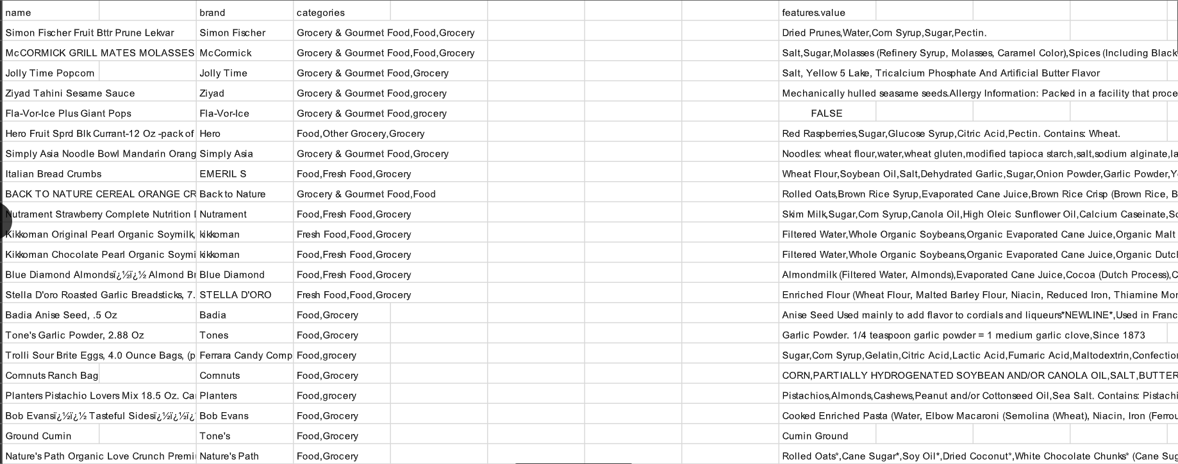
Ingredients Dataset
It contains 10000 packaged food item names along with the ingredients present in it.We used this dataset for analysing efficient algorithm. This dataset was cleaned and processed into packaged food dataset
(refer slide 7)
Reference: https://www.kaggle.com/datafiniti/food-ingredient-lists

Slide 9
DATA PREPROCESSING
Deleted adjectives such as “exceptionally high quality” and vitamin ingredients and products
Kept adjectives that indicate food processing, e.g. “bleached white flour” and “roasted almonds”, “organic”, “dried berries”., “whole wheat” and “blue corn” because they are types that could have different ingredient implications compared to “wheat” and “corn”.
Deleted “whole” in “whole strawberries” because this type doesn’t appear to change the ingredient list.
Any “may contain” or “added” ingredients are treated as regular ingredients and parsed the same as the others.
Kept ambiguous ingredient references, e.g. “other flavors”, etc.

Slide 10
DATA PREPROCESSING
Deleted “Reverse Osmosis water”, non-food items, e.g. The One-time-use Pack! Wipe 70gx5
Unreadable characters were deleted, e.g. Waterï¿½ï¿½ï¿½Spring Water.Sub Bunï¿½ï¿½ï¿½
All the ingredients were split from one cell to multiple cells. (one ingredient per cell)
Normalized terms, e.g. “popping corn” and “popcorn”, “oat” and “oats”
Fixed typos

Slide 11
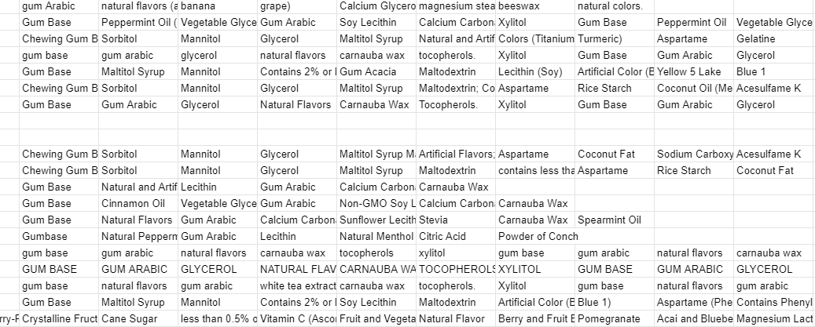
Dataset after Preprocessing

Slide 12
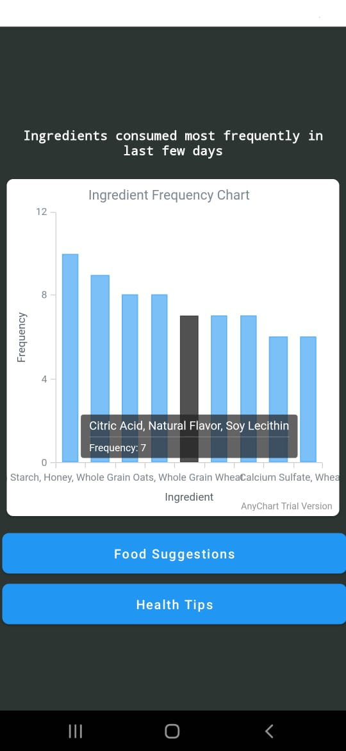
Applying FP-Growth Algorithm on Preprocessed data
FP GROWTH ALGORITHM:
FP growth is a tree based algorithm to mine frequent patterns in the database.
It is applicable to projected type databases.
It uses the divide and conquer method.
No candidate frequent itemset is needed rather frequent patterns are mined from the fp tree.
We have used FP growth algorithm, as it was the most efficient algorithm for large datasets.
Notes:
#remove or explain, find flow chart of algo

Slide 13
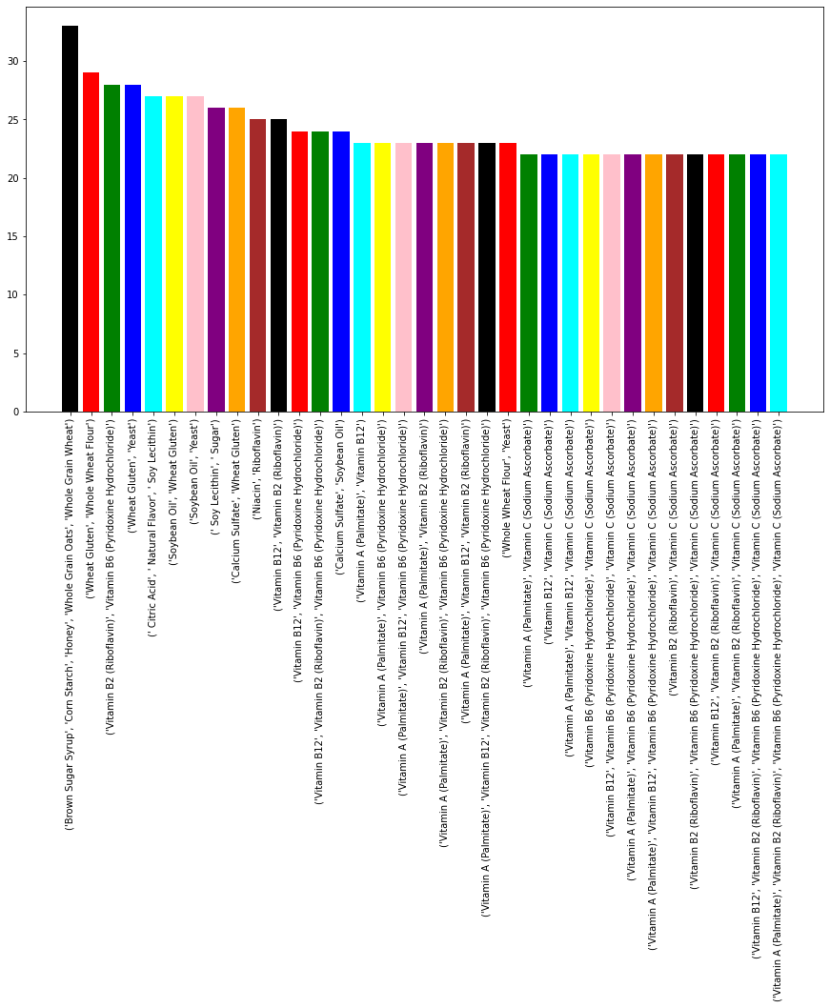
RESULTS:
Minimum Support: 20%
Confidence: 80%
Minimum items in set: 2
Total Items found: 8490
Time Taken: 0.12604 seconds
Notes:
#remove or explain, find flow chart of algo

Slide 14
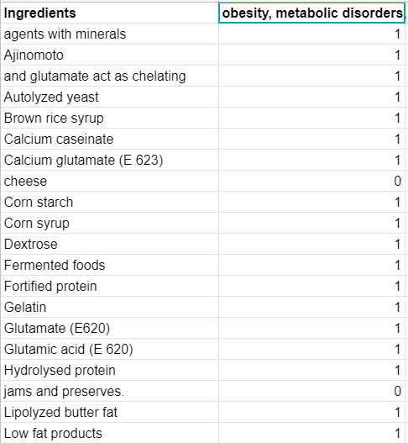
INGREDIENTS DISEASE DATASET
To generate the dataset consisting of disease prone flags, we have created 2 columns (Ingredient Name and Disease prone or not). Based on the data available in research papers.
The ingredients were classified into 0 and 1.Flag “1” was stating that the ingredient is prone to the disease, Flag “0” was stating that the ingredient is safe to consume keeping the same disease in mind.

Slide 15
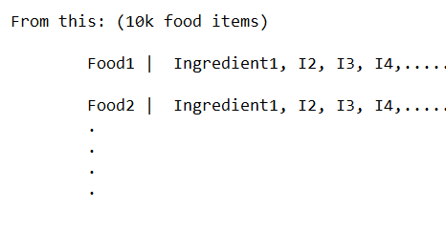

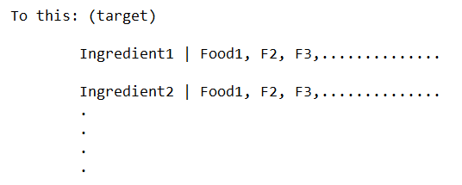
INGREDIENT-FOOD DATASET
Using Ingredients dataset, we obtained a dataset of ingredients and the food items that contains them. Tokenized using NLTK library and cleaned
List of distinct ingredients was formed that contained every non repetitive and distinct ingredient
From this, every word was looped from the ingredients dataset and all the food items that contained that particular ingredient was saved

Slide 16
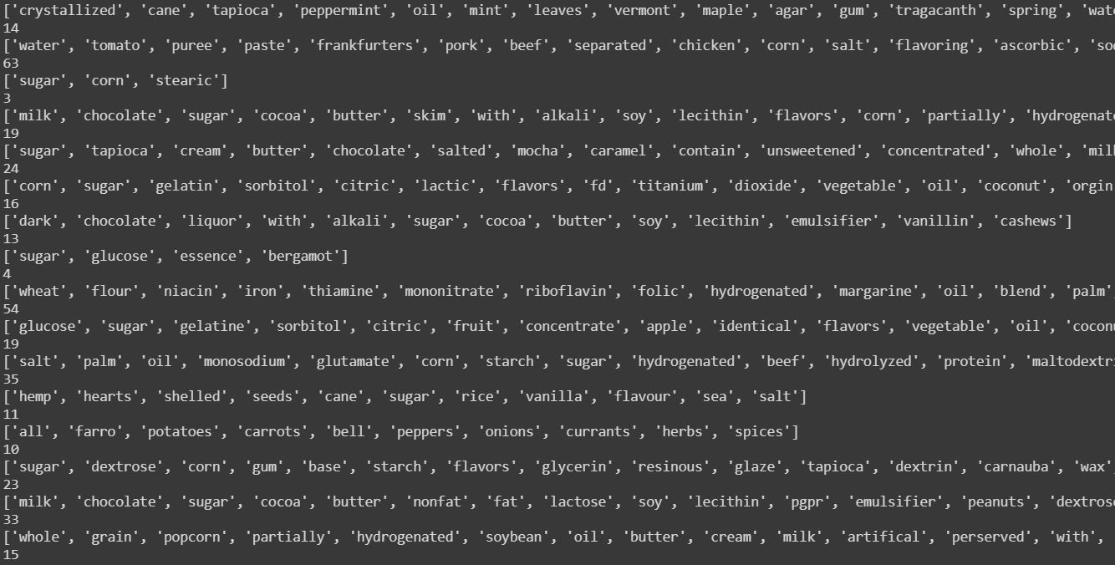
INGREDIENT-FOOD - Tokenized ingredients

Slide 17
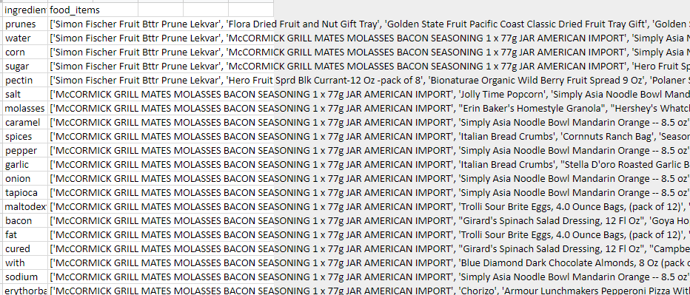
INGREDIENT-FOOD DATASET

Slide 18
Suggesting Packaged Food Items
Based on the results of Fp growth algorithm, most frequent items consumed by the users are then used for suggesting other packaged food items of their choice.
Get a list of highest frequency items.
Initialize a list variable as mylist.
Loop through each value in the highest freq items list.
For every ingredient in the Ingredient food dataset.
If the highest frequency item name is equal to ingredient name.
  then append mylist.
else
  do nothing
end if
make a set of mylist items and print the set items.
Notes:
#remove or explain, find flow chart of algo

Slide 19
Result after food suggestion
['BACK TO NATURE CEREAL ORANGE CRUNCH GRAN',
"Erin Baker's Homestyle Granola",
'Russell Stover Assorted Fine Chocolates, 7.0 Oz',
'Honey Mustard',
'Iced Tea - Unsweetened Brewed',
"Herr's Real Chocolate Covered Pretzel Sticks, 5 Oz",
'Russell Stover Assorted Fine Chocolates, 34.0 Oz',
"Nature's Path Organic Heritage Crunch Cereal, 14.0 Oz",
'Quaker Real Medleys Fruit & Nut Multigrain Bars, Cherry Pistachio, 1.34 Oz Bar, 10/box -qkr31799',
'Bakery On Main Gluten Free Non-gmo Nut Crunch Snack']

Slide 20
Health Tip Generation
Algorithm:
Get a list of highest frequency items.
Initialize a list variable as mylist.
Loop through each value in the highest freq items list.
For every ingredient i in disease dataset.
If the highest frequency item name is equal to ingredient name.
  Then print “Ingredient i is harmful for your health.”
else
  do nothing
end if
Used disease dataset.
If any ingredient is disease prone then the user will get notified.
Notes:
#remove or explain, find flow chart of algo

Slide 21
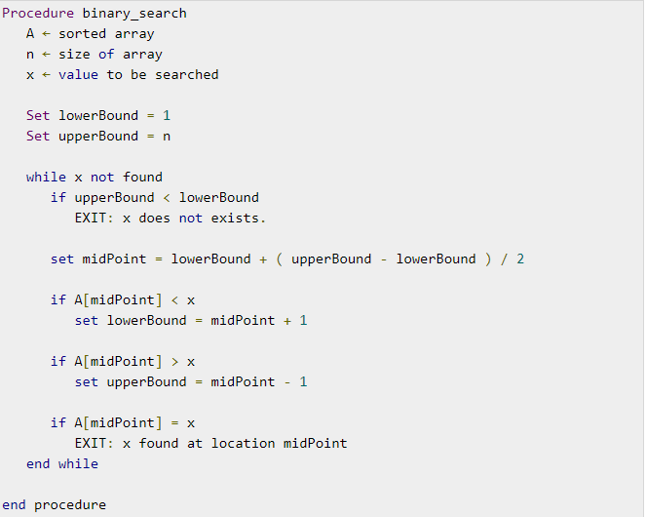
BINARY SEARCH
algorithm works on the principle of divide and conquer
the data collection should be in the sorted form.
Best for large and sorted datasets

Slide 22
Health Tip Generation
Improved Algorithm:
Get a list of highest frequency items.
Initialize a list variable as mylist.
Loop through each value in the highest freq items list.
Apply binary search algorithm for every ingredient in the disease dataset.
initialize a variable val.
If the ingredient i is found in the Disease dataset.
  set val -> index of ingredient returned
Else
  set val as -1
if val is equal to -1
  Then print “Ingredient i is harmful for your health.”
Notes:
#remove or explain, find flow chart of algo

Slide 23
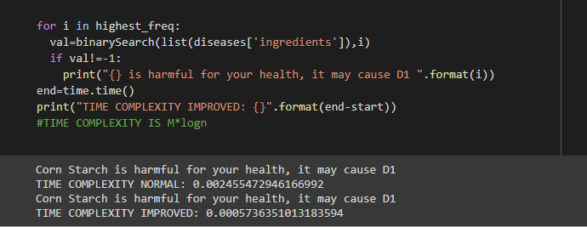
Result after health tip generation

Slide 24
Health Star Rating
The Health Star Rating is a front-of-pack labelling system that rates the overall nutritional profile of packaged food and assigns it a rating from ½ a star to 5 stars. It provides a quick, easy, standard way to compare similar packaged foods. The more stars, the healthier the choice.
To objectively analyse the relevant information, regulators have used the categorization approach, wherever teams of comparable merchandise area unit clubbed along joined class. This class is employed because the basic unit for capturing data and driving higher cognitive process in regulatory frameworks.

Slide 25
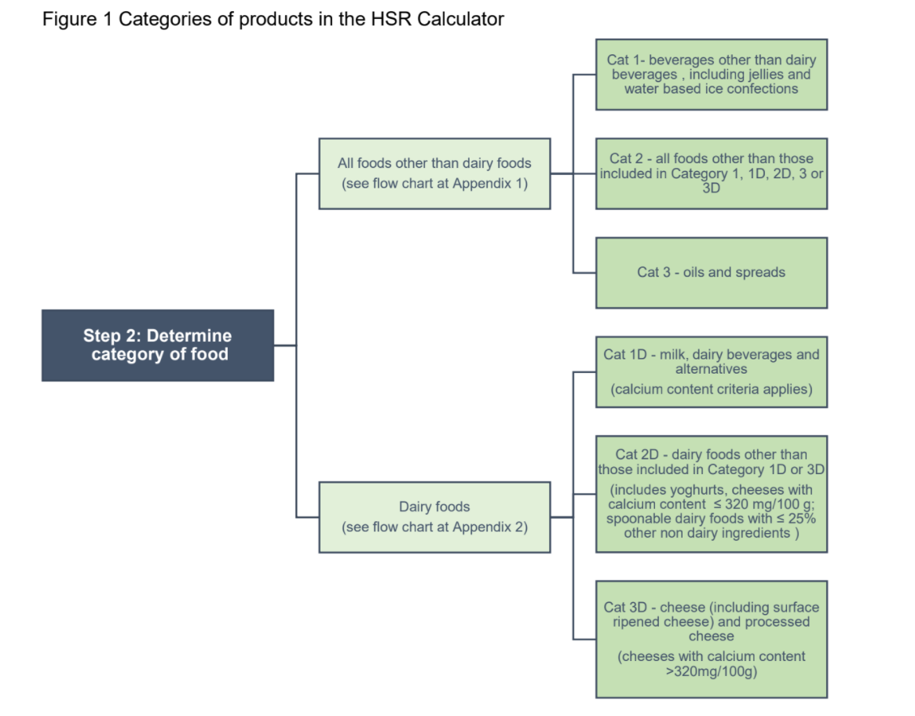
Categorization
We categorized the ingredients in 12 groups.
Eggs Seafood Cereals
Oil products Dairy items
Non-alcoholic Beverages
Sauces and Dressings Meat products
Bread and Bakery products
Sugar and Honey items
Confectionaries

Slide 26
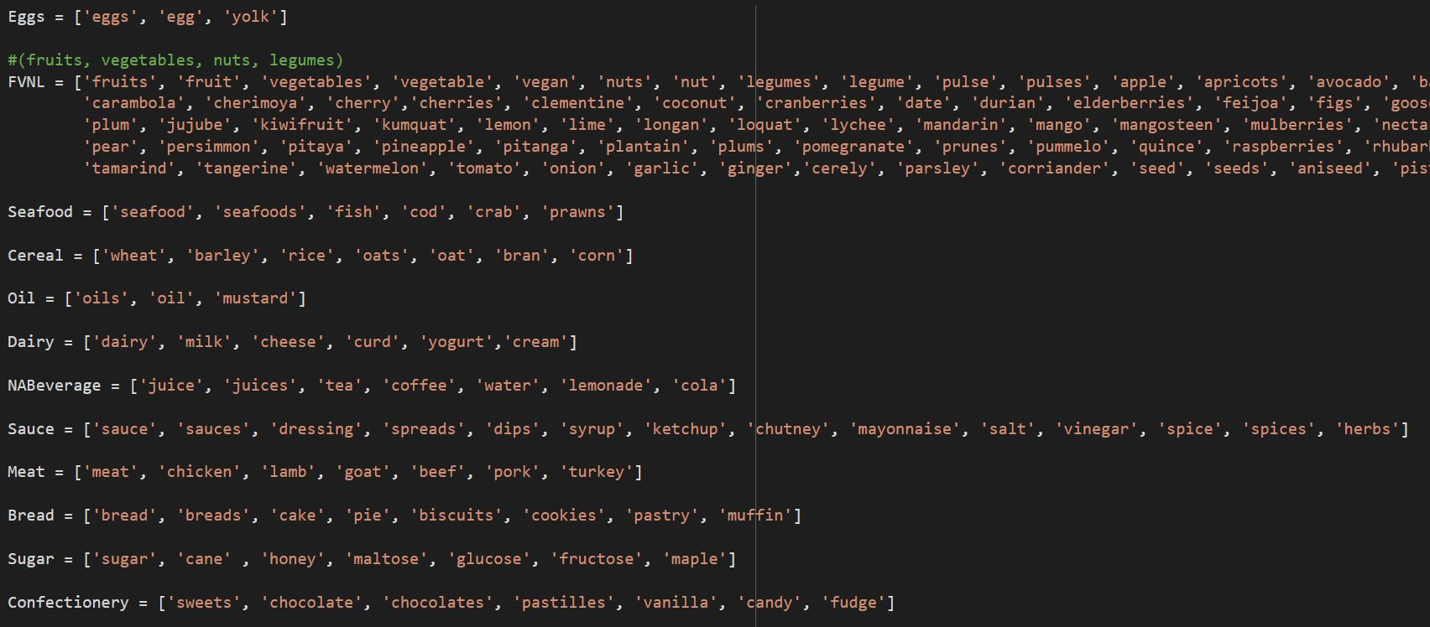
A dataset of ingredients according to their category was generated:

Slide 27
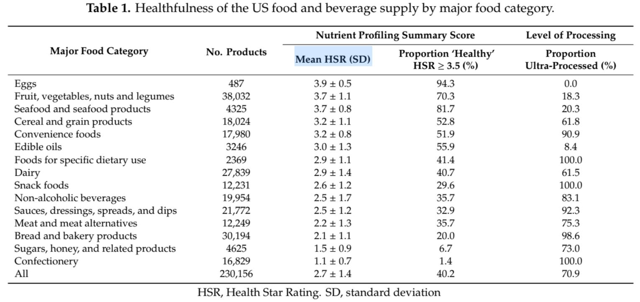
Calculation
The food item was searched and its ingredients were categorised.
The MHS value of ingredients were assigned and average was calculated for the food item.
0 < Rating <= 2 = LOW
2 < Rating <= 3 = MEDIUM
3 < Rating < 5 = HIGH /
Healthy

Slide 28
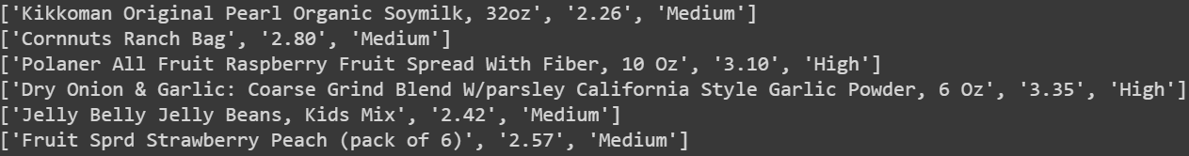
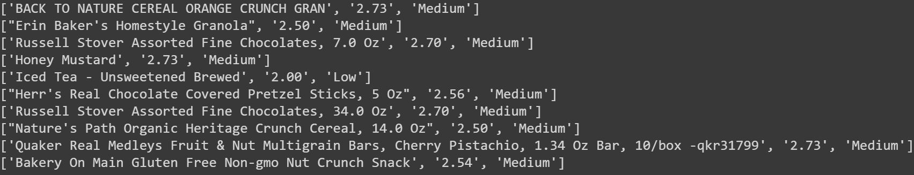
Final HSR ratings of food products.
Output 1
Output 2

Slide 29
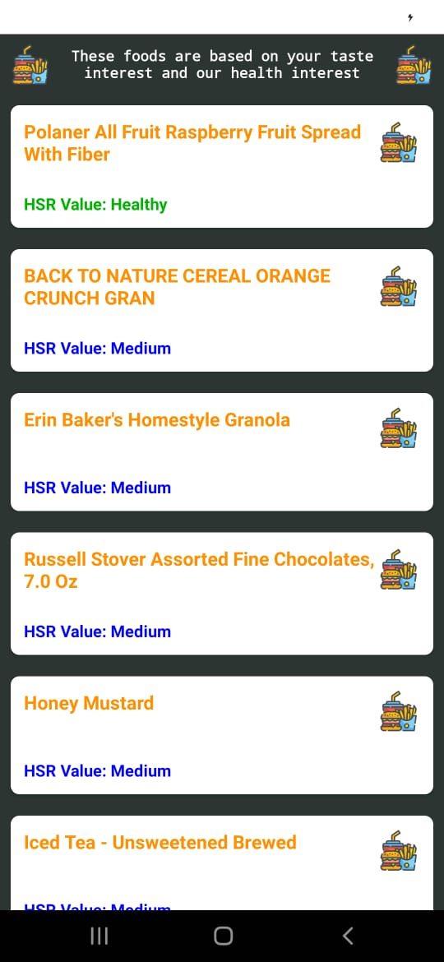
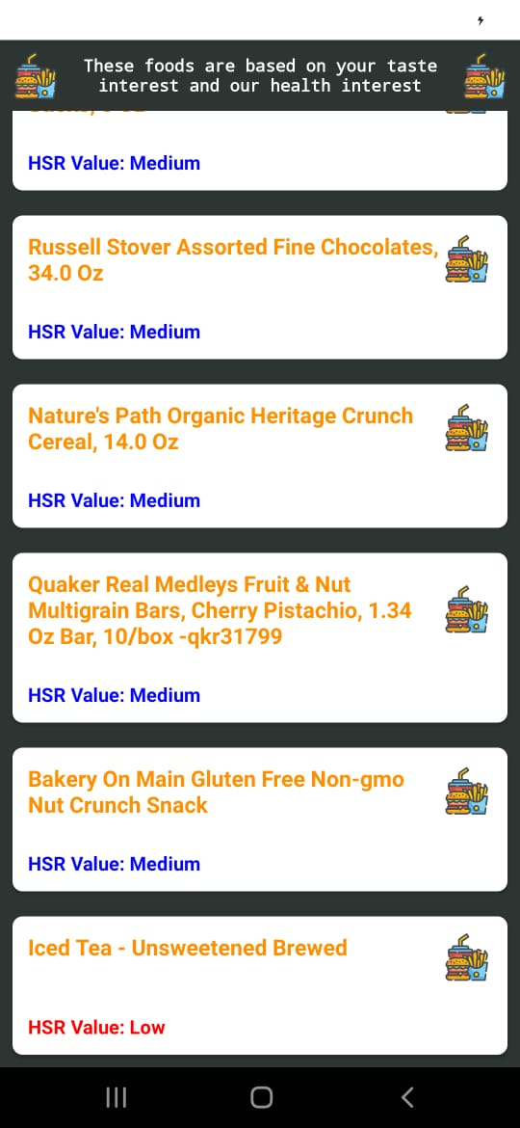
3 < Rating < 5 = High
2 < Rating <= 3 = Medium
0 < Rating <= 2 = Low

Slide 30
RESULTS:
From the above results we can see that :
We are able to suggest packaged food item from most frequent ingredients consumed by the user.
We are able to generate health tip from most frequent ingredients consumed by the user.
Food item is suggested along with Health Rating and in Low , Medium or High/Healthy category.

Slide 31
Conclusion
There is a scope to implement health tips based on consumption patterns.
Ingredients prone to diseases can be used after classifying them for further developments.
We found the efficient algorithm to suggest the food data.

Slide 32
LIMITATIONS
The obstacles arise due to different factors like,
Lack of proper dataset of daily consumption of different age groups.
There are many unlikely values which do not provide good efficiency.
There are several keywords available like numerical values, some inconsistent prepositions, etc.
This is a generalised application for every user. We need to modify this for user-specific requirements.

Slide 33
FUTURE SCOPE
We can take Allergies and other health related problems into consideration.
Healthier food alternatives can be suggested to users.
Further preprocessing is required (Undecided terms such as “Gluten free” & “Gluten”)
We can develop a machine learning model which will help in generating the tips with the help of binary classification problems.
Obesity can also be traced with the help of calories intake.

Slide 34
THANK YOU !

Slide 35
APPENDIX

Slide 36
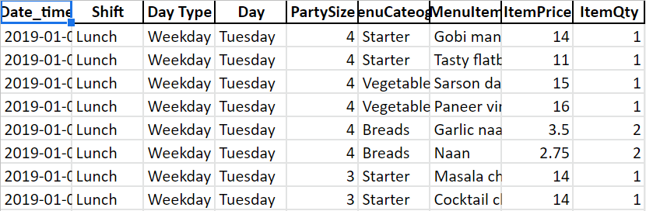
Restaurant Dataset

Slide 37
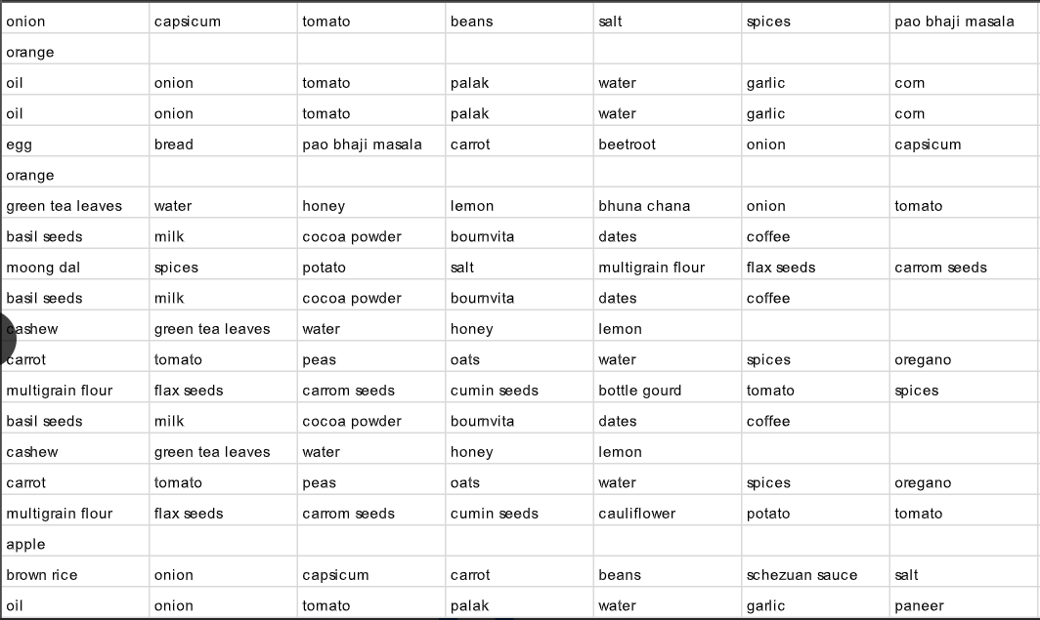
Homemade food Dataset

Slide 38
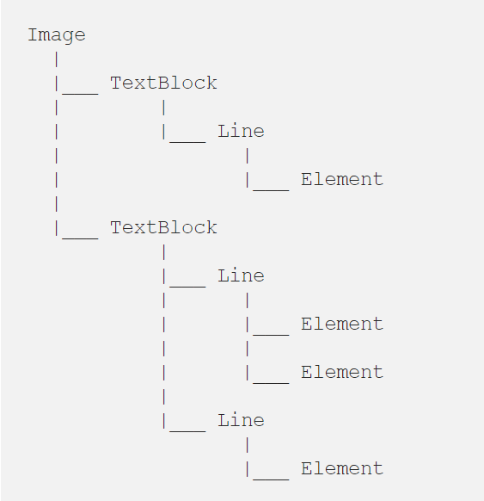
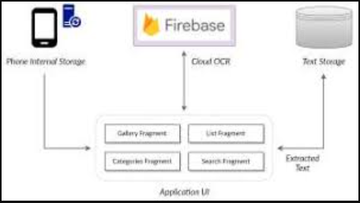
Text Recognition
Text Recognition will be done with the help of Text Recognition API, part of ML Kit for Firebase.
Document text recognition is available only as a cloud-based model.
ML Kit works with TensorFlow, and this is a machine learning library for iOS and Android operating systems.
Notes:
Through Image, how ?

Slide 39
APRIORI ALGORITHM
It is used to extract frequent itemsets from a large database and get the association rule for discovering the knowledge.
The algorithm makes many searches in the database to find frequent itemsets where k itemsets are used to generate k+1-itemsets.
Each k-itemset must be greater than or equal to the minimum support threshold to be frequency.
The main limitation is costly wasting of time to hold a vast number of candidate sets with much frequent itemsets, low minimum support or
large itemsets.

Slide 40
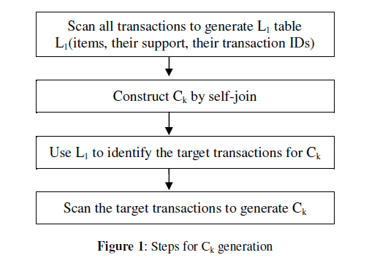
Improved Apriori Algorithm
//Generate items, items support, their transaction ID
(1) L1 = find_frequent_1_itemsets (T);
(2) For (k = 2; Lk-1 ; k++) {
//Generate the Ck from the LK-1
(3) Ck = candidates generated from Lk-1;
//get the item Iw with minimum support in Ck using L1, (1wk).
(4) x = Get _item_min_sup(Ck, L1);
// get the target transaction IDs that contain item x.
(5) Tgt = get_Transaction_ID(x);
(6) For each transaction t in Tgt Do
(7) Increment the count of all items in Ck that are found in Tgt;
(8) Lk= items in Ck min_support;
(9) End;
Notes:
#remove or explain, find flow chart of algo

Slide 41
ECLAT Algorithm
Eclat is a vertical database layout algorithm used for mining frequent itemsets.
It is based on a depth first search algorithm.
The data is represented in a bit matrix form.
If the item is bought in a particular transaction the bit is set to one else to zero.
After that a prefix tree needs to be constructed.
Notes:
#remove or explain, find flow chart of algo

Slide 42
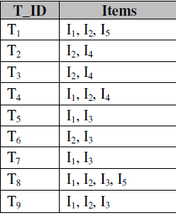
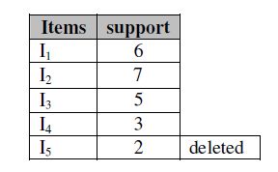
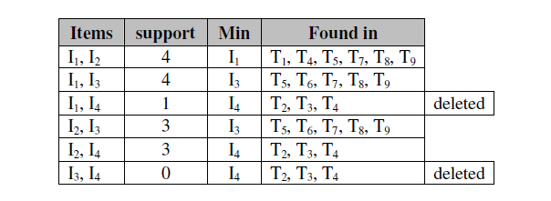
Example of the Improved Apriori
Notes:
#remove or explain

Slide 43
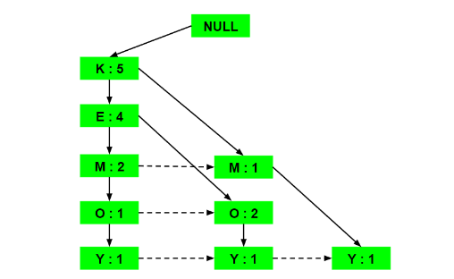
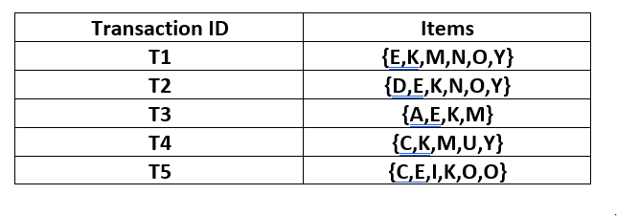
Example of the FP-Growth
Notes:
APPENDIX: containing all examples

Slide 44
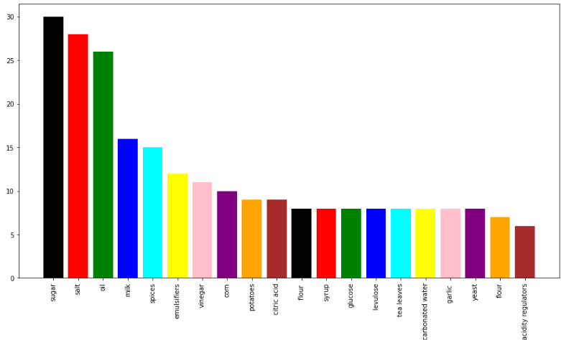
Frequent Ingredients Consumed
TESTING AND RESULTS
As we can see the most frequent and necessary ingredients are salt, sugar and oil. These affect the health of adolescents the most. So we will be tracking these separately. The time taken to calculate frequent items was 0.010021 secs.

Slide 45
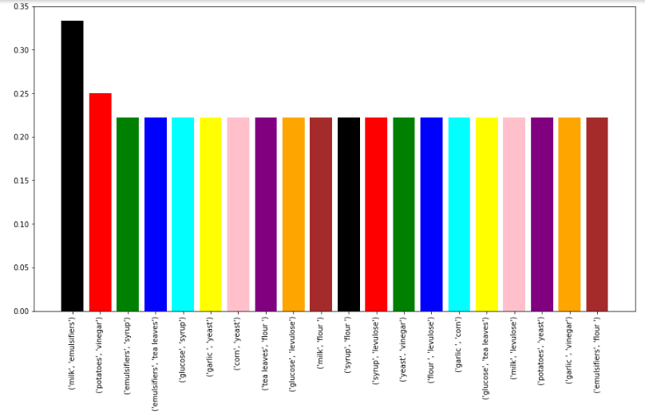
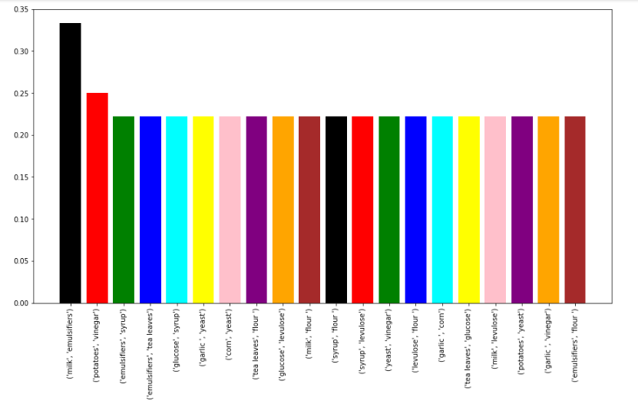
Apriori Improved Apriori
TESTING AND RESULTS
Minimum Support: 20%
Confidence: 80%
Time Taken ; Apriori: 0.02108 secs
Time Taken ; Improved Apriori: 0.00672 secs
Hence, we can infer that the Apriori Algorithm can be improved.
Notes:
What are u showing in graph, explain

Slide 46
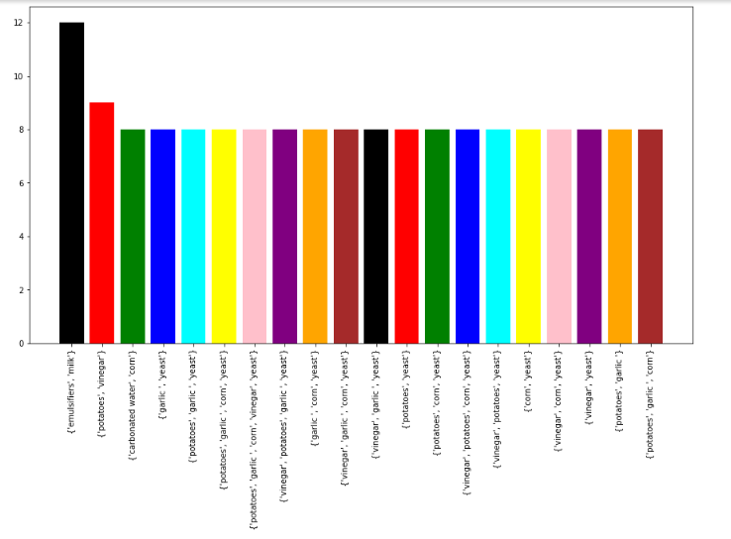
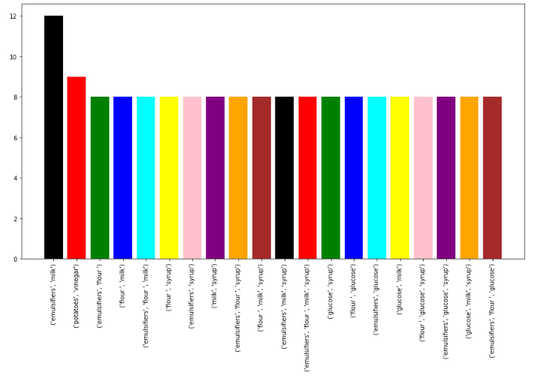
ECLAT FP-Growth
TESTING AND RESULTS
Time Taken; ECLAT: 0.00069 seconds Time Taken; FP Growth: 0.00174 seconds
Hence, we can infer that both ECLAT and FP Growth are more efficient than Apriori original and improved algorithms

Slide 47
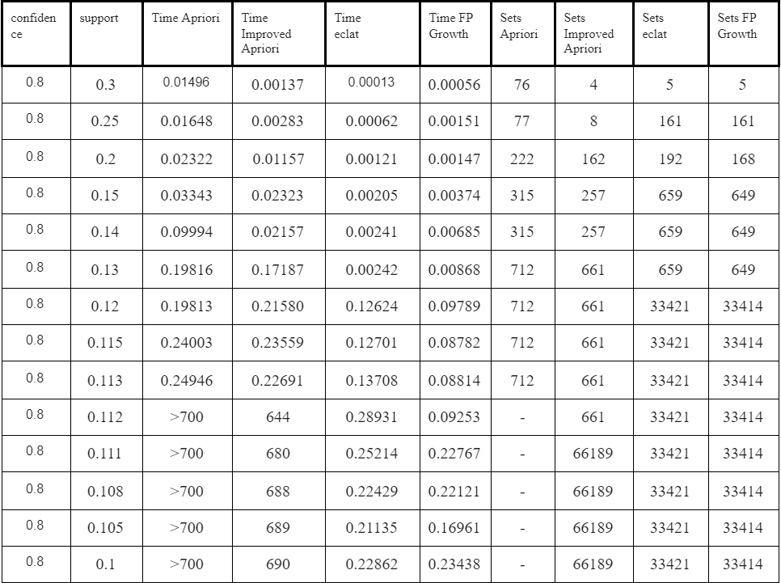
PERFORMANCE
ANALYSIS
OF ALGORITHMS
WITH CHANGING SUPPORT VALUES
Notes:
Comparison of terms and explain the purpose of comparison

